Slide 1


Power BI Meets Programmability
Kristyna Hughes

Slide 2

About Me ~ Kristyna Hughes
Senior data & analytics consultant at 3Cloud, PASS MN Board Member, Lexington Data Technology Group co-organizer , co-author on DataOnWheels, co-founder of Data On Rails
My experience includes implementing and managing enterprise-level Power BI instances, training teams on reporting best practices, learning new coding languages to hack into Power BI, and building templates for scalable analytics.
Check out my blog: https://dataonwheels.wordpress.com/
Check out my blog platform: https://dataonrailsblog.wordpress.com/
Connect on LinkedIn: https://www.linkedin.com/in/kristyna-hughes-dataonwheels/
Connect on Twitter: @data_dragoness
GitHub

Slide 3

Why are we talking about C#?

Slide 4

BI & App Dev, Better Together
Scalability
Adaptability
Programmability

Slide 5
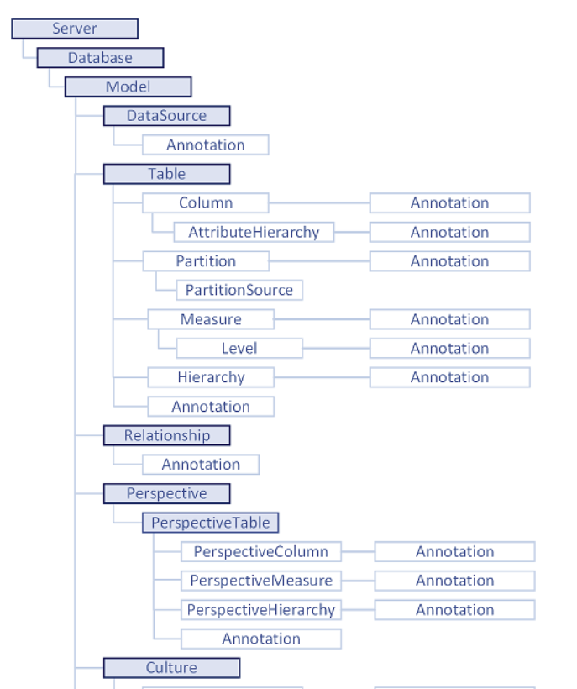
Important Terms
Tabular Object Model (TOM) : exposes native tablular metadata objects in order to support programming tabular models (aka Power BI, SSAS, AAS)
Analysis Services : an analytical data engine (VertiPaq) that provides semantic data models for reports and applications (i.e. Power BI, Excel, Reporting Services, etc).
XMLA Endpoint : XML for analysis. Communicates between applications and the Analysis Services engine. Data sent over XMLA is fully encrypted. Requires Power BI Premium or Premium Per User workspace.

Slide 6

What can XMLA & TOM impact?
Columns, measures, calculated columns
Hierarchies
Translations
Perspectives
Dataset metadata (including estimated size!)
Formatting
Refresh, create, and clone datasets
Automated partition management
Add relationships between tables
And more!

Slide 7


The Biggest Limitation
You cannot export your PBIX file from the service after interacting with it via XMLA. Please vote up this idea and tell your friends and family to do the same!

Slide 8
Tools Needed to Mimic this Demo
Brave spirit to face down C#
Power BI Premium Workspace
Powe BI Pro License
.NET 5.0
.NET Core
Visual Studio
XMLA Endpoint Read Write enabled in Admin Portal
Detailed instructions are available in this blog post: https://dataonwheels.wordpress.com/2021/10/15/power-bi-meets-programmability-tom-xmla-and-c/

Slide 9

Demo Time!

Slide 10

This is cool and all, but what about TMDL?

Slide 11
This is cool and all, but what about TMDL?
Use TMDL inside your C# project!
TMDL deserializes TOM for human readability
No crazy brackets
It is whitespace sensitive, so be careful
You can make edits to the model using TMDL and implement them via XMLA

Slide 12
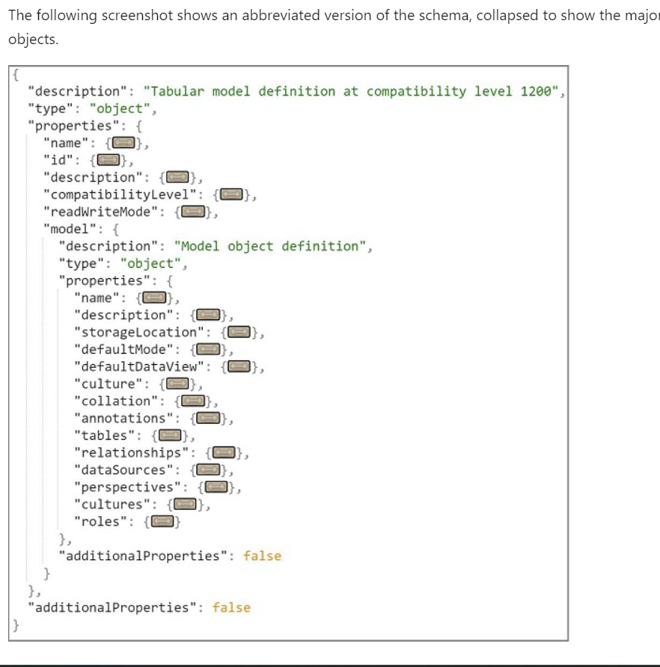
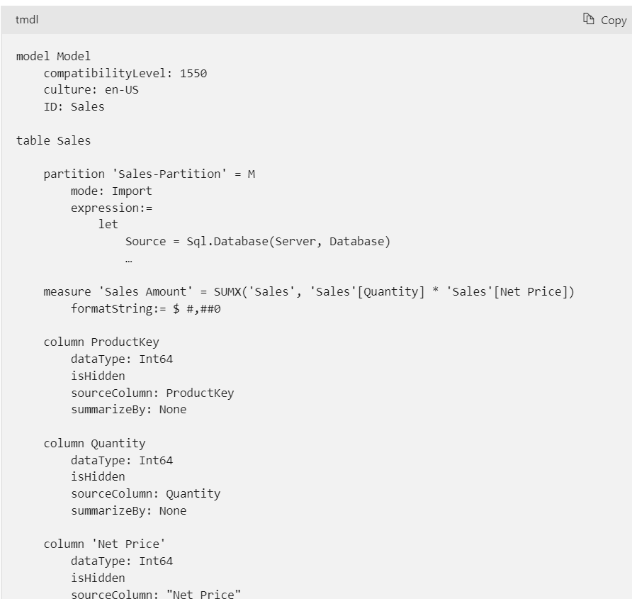
Why is TMDL revolutionary?

Slide 13
Demo Time! …again!

Slide 14

Questions?

Slide 15

Don’t forget to connect, thanks for listening!
Blog: https://dataonwheels.wordpress.com/
Email: Kristyna@dataonwheels.com
Twitter: @data_dragoness
LinkedIn

